Slide 1
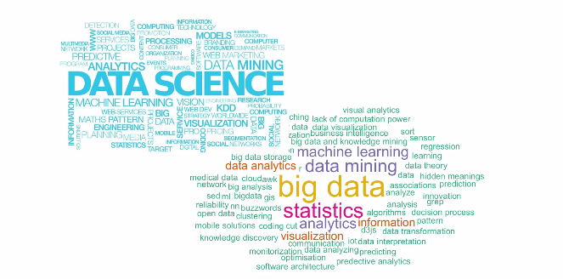
Data Science – Day 4

Slide 2
Recap
Assesment

Slide 3
Modelling

Slide 4
Exercises

